Slide 1
Fashion Recommendation System
GROUP MEMBERS :
SAKSHI RANE – 75
SHWETA AHER - 77
ABHISHEK BHALERAO – 68
ROHIT VERMA – 32

Slide 2
Contents :
TITLE | SLIDE NUMBER
DOMAIN – MACHINE LEARNING | 3
INTRODUCTION TO PROJECT TITLE | 5
PROBLEM STATEMENT | 6
PURPOSE | 7
PROJECT SURVEY | 8
SYSTEM ARCHITECTURE | 9
DATA SET AND CLASSIFICATION | 13
SOFTWARE’S, LANGUAGES AND LIBRARIES | 14
SOFTWARE DEVELOPMENT LIFE CYCLE | 15
RESULT | 16
CONCLUSION | 17
REFERENCES | 18

Slide 3
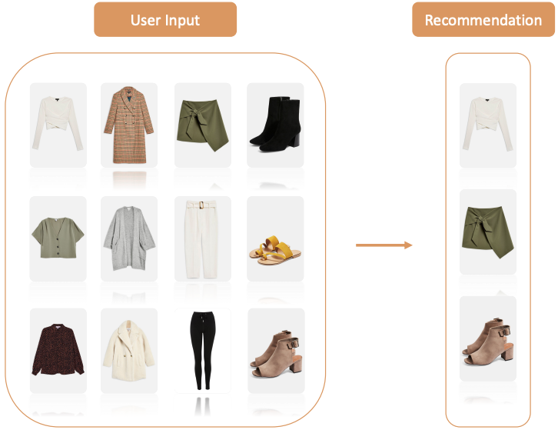
Domain – machine learning
Machine learning is a branch of artificial intelligence :
Uses computing based systems to make sense out of data
Extracting patterns, fitting data to functions, classifying data, etc.
ML systems can learn and improve
With historical data, time and experience
Bridges theoretical computer science and real noise data.

Slide 4
Define Objectives
Data Preparation
Model Building
Model Deployment
Model Evaluation
-Define measurable and quantifiable goals
-Use this stage to learn about the problem
-Placing a finished machine learning model into a live environment where it can be used for its intended purpose.
MACHINE LEARNING AS A PROCESS
-Normalization
-Transformation
-Missing Values
-Outliers
-Study models accuracy
-Works better than the naïve approach or previous system
-Do the results make sense in the context of the problem
-Data Splitting
-Features Engineering
-Estimating Performance
-Evaluation and Model Selection

Slide 5
INTRODUCTION TO PROJECT TITLE
A Fashion Recommendation System with Machine Learning works like a highly personalized online shopping recommendations.
A recommendation system is a system that is programmed to predict future preferable items from a large set of collections.
A recommendation system works either by using user preferences or by using the items most preferred by all users.
The main challenge in building a fashion recommendation system is that it is a very dynamic industry. It changes very often when it comes to seasons, festivals, pandemic conditions like coronavirus and many more.

Slide 6
PROBLEM STATEMENT
According to the results of the previous study, we discovered that there are issues with accuracy, a lack of data, and user dissatisfaction with the system's recommendations.
So, we decided to develop two inceptions based convolutional neural networks as prediction part and one feed forward neural network as recommender.

Slide 7
Purpose
The purpose of the project is to build a model capable of doing fashion recommendation by just looking at its image. The model accepts a image and first determines whether the image contains a fashion product or not and recommend it accordingly. The main objective of this work is to:
• Develop a fashion recommendation system which answers the queries related to fashion shopping.
To identify the fashion type of given input image.
If the given fashion image is valid then similar set of clothing will be recommended.

Slide 8
PROJECT SURVEY
PAPER NAME | AUTHOR, PUBLICATION, YEAR | DESCRIPTION
Fashion Recommendation Systems, Models and Methods: A Review | Samit Chakraborty, Md. Saiful Hogue, Naimur Rahman Jeem, Manik Chandra Biswas, Deepayan Bardhan, Edgar Lobaton | With the help of this research paper we got the idea to build a fashion recommendation system, seeing the growth in fashion. It also gave us the idea to build a personalized shopping experience to customers by their own choices.
Fashion Recommendation System using CNN | Anjan M., Abhishek V, C. Balamanikantan, Dheeraj, Dr. Venugeetha Y. | With the help of this research paper we found that here Website allows the users to find products through an image. The user will be presented with products which the model deemed to be similar to the uploaded image.
Fashion Recommendation System using Machine Learning | Anjali Singh, L Naga Sai Jawahar, Anumula Thrayakshara, Dr. K Vanitha | With the help of this research paper we found that here that the data gathered from the program, specifically, is expected to be utilized utilizing popular assessment.

Slide 9
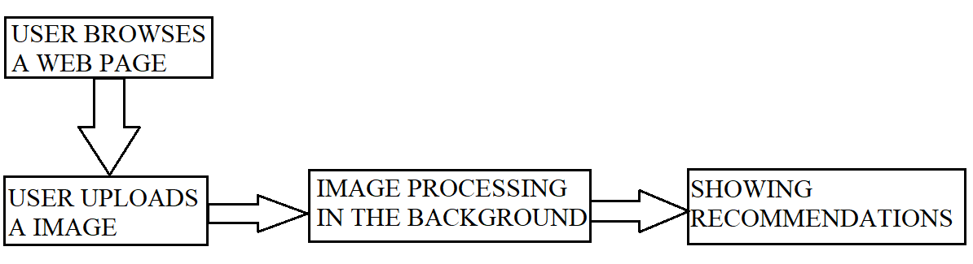
SYSTEM ARCHITECTURE
The proposed system is divided into Four parts: • Image pre-processing • Recommendation Engine • Web Scraping • Website

Slide 10
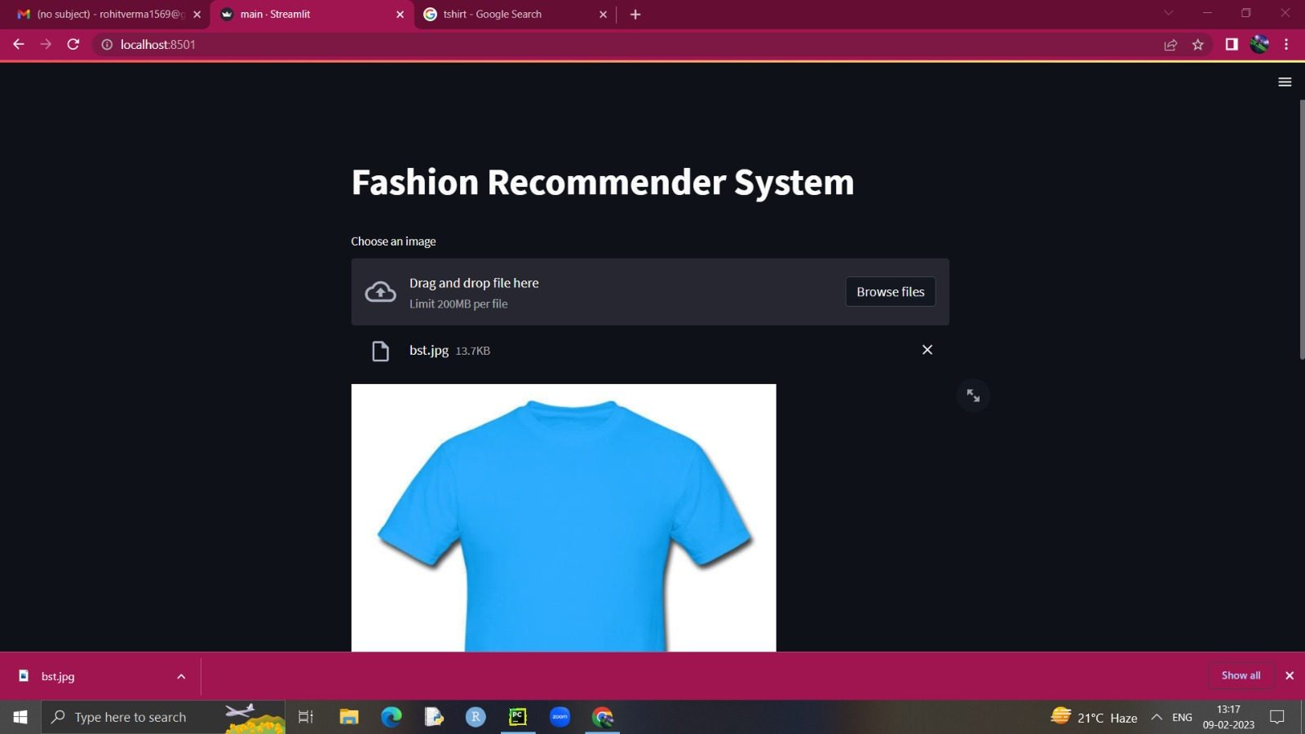

Slide 11
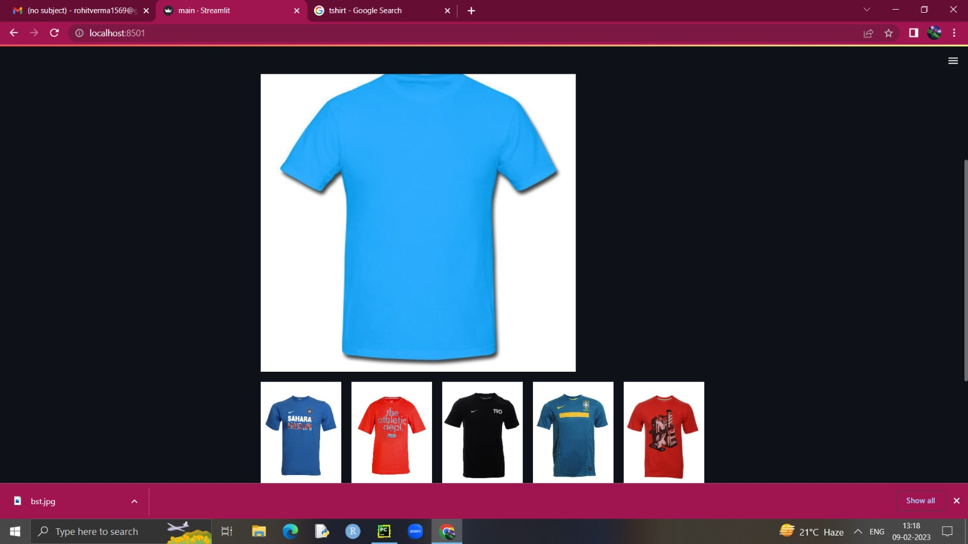

Slide 12
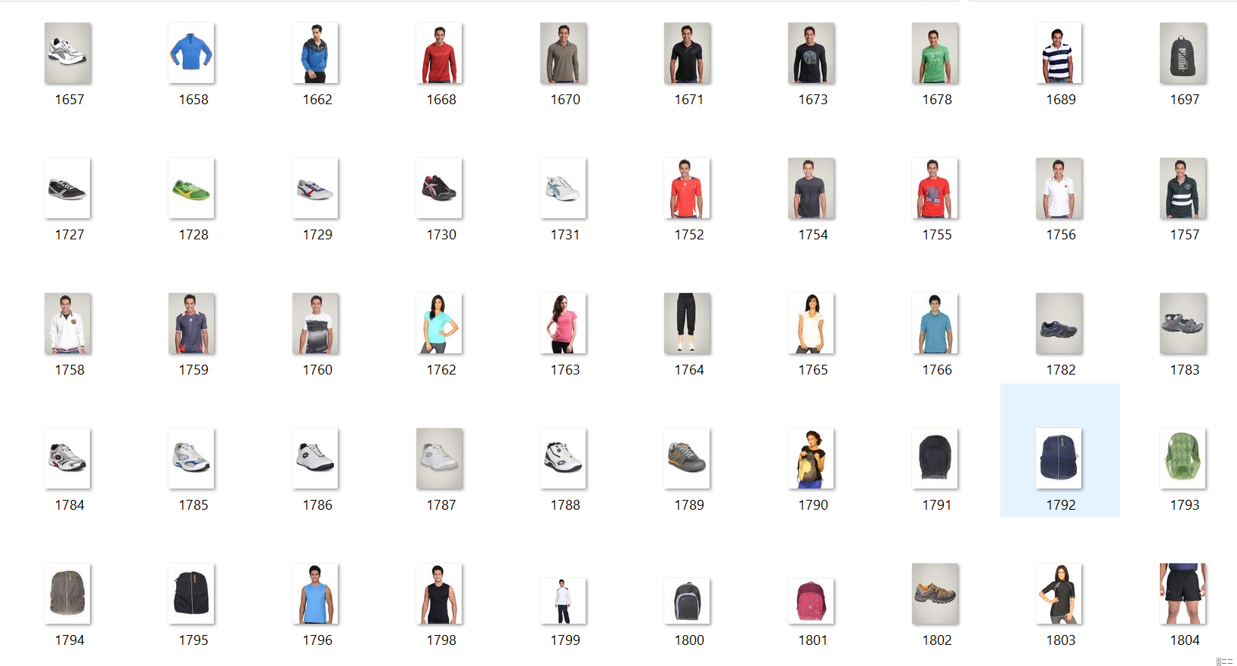
DATA SET AND CLASSIFICATION

Slide 13
SOFTWARE’S, LANGUAGES AND LIBRARIES
Software used : PyCharm
Language used : Python
Libraries used :
Pickle | OS
Scikit Learn | Tensorflow
TQDM | Streamlit

Slide 14
Software development life cycle
PHASE 1 – PLANNING AND ANALYSIS
According to the problem statement given we will plan the requirements and process. And even analyze the planned structure for any future error.
PHASE 2 – DESIGNING THE PRODUCT
In this phase we will design the product according to the plan made earlier.
PHASE 3 – DEVELOPING AND CODING
Here we will write the code as per required and define methods.
PHASE 4 – TESTING
In testing we will test the various test cases like for example- clothing available for women according to their suitability.
PHASE 5 – MAINTENANCE
Here we will keep updating the dataset we new arrivals of costumes so that more people get engaged.

Slide 15
Result
This Website allows the users to find products through an image. It provides an easy to use interface which assists the user in finding a product which they might find visually appealing to them by simply clicking an image of the product and uploading it on the Website. The user will be presented with products which the model deemed to be similar to the uploaded image.

Slide 16
Conclusion
Fashion Recommendations System is the best way to deliver customers with an improved user experience. Through machine learning and specific algorithms, a Fashion Recommendation System can help to bring customers the relevant products they want or need.

Slide 17
Refernces
1. Barnard, M. Fashion as Communication, 2nd ed.; Routledge: London, UK, 2008.
2. Chakraborty, S.; Hoque, S.M.A.; Kabir, S.M.F. Predicting fashion trend using runway images: Application of logistic regression in trend forecasting. Int. J. Fash. Des. Technol. Educ. 2020, 13, 376–386, doi:10.1080/17543266.2020.1829096.
3. Karmaker Santu, S.K.; Sondhi, P.; Zhai, C. On application of learning to rank for e-commerce search. In Proceedings of the 40th International ACM SIGIR Conference on Research and Development in Information Retrieval, Shinjuku Tokyo Japan, 7–11 August 2017; pp. 475–484, doi:10.1145/3077136.3080838.
4. Garude, D.; Khopkar, A.; Dhake, M.; Laghane, S.; Maktum, T. Skin-tone and occasion oriented outfit recommendation system. SSRN Electron. J. 2019, doi:10.2139/ssrn.3368058.
5. Kang, W.-C.; Fang, C.; Wang, Z.; McAuley, J. Visually-aware fashion recommendation and design with generative image models. In Proceedings of the 2017 IEEE International Conference on Data Mining (ICDM), New Orleans, LA, USA, 18–21 November 2017; pp. 207–216, doi:10.1109/ICDM.2017.30.
6. Sachdeva, H.; Pandey, S. Interactive Systems for Fashion Clothing Recommendation. In Emerging Technology in Modelling and Graphics; Mandal, J.K., Bhattacharya, D., Eds.; Springer: Singapore, 2020; Volume 937, pp. 287–294, doi:10.1007/978-981-13-7403- 6_27.
7. Sun, G.-L.; Wu, X.; Peng, Q. Part-based clothing image annotation by visual neighbor retrieval. Neurocomputing 2016, 213, 115– 124, doi:10.1016/j.neucom.2015.12.141.
8. https://thecleverprogrammer.com/2020/08/16/fashion-recommendation-system/

Slide 18
THANK YOU !

